Slide 1

Data Integration and Large Scale Analysis 03 Replication, MoM, and EAI
Slides credit: Matthias Boehm
Last update: Oct 25, 2024

Slide 2
Agenda
Overview of Exercises
Motivation and Terminology
Distributed TX & Replication Techniques
Asynchronous Messaging
Message-oriented Integration Platforms

Slide 3
Overview Programming Projects & Exercises

Slide 4
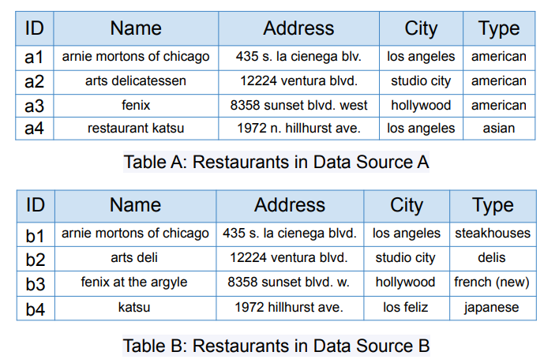
Overview Projects or Exercises
Course Outline and Projects
Team
1-3 person teams (w/ clearly separated responsibilities)
Exercise description on the TeachCenter
Projects announcement next week
Pei Wang et al. ICDE 2021

Slide 5
Exercise
Description: The task is to create a pipeline for entity matching by following all the necessary steps of cleaning, blocking and similarity matching. Once such pipeline is ready it can be used to train a ML model for predicting new records. This exercise could be completed in a group of maximum 03 students. Use the benchmarked datasets of “Amazon-GoogleProducts” for entity resolution. The datasets can be downloaded from the link (https://dbs.uni-leipzig.de/research/projects/benchmark-datasets-for-entity-resolution).
[Task 01]: Entity matching (40 Points)
Prepare data (apply necessary cleaning/transformations or normalization)
Extract key features and implement a blocking scheme
Identify the similar records from both datasets and calculate their similarity scores. Count the number of pairs whose similarity is greater than 0.95
Use the PerfectMapping file to report the accuracy of your pipeline

Slide 6
Exercise
[Task 02]: Feature vector and ML model (50 Points)
Create a training dataset with binary label using the output pairs of tasks 1 (If the similarity of pairs is equal to 1.0 label them as “1 or matched” otherwise “0 or unmatched”)
Compute atleast six new features from the given features (i.e., Levenshtein, Jaccard or cosine similarity between descriptions of Google and Amazon features)
Preprocess your training dataset (impute missing values, handle class imbalance)
Train a machine learning model using k=3 cross validations and report precision, recall and F1-score
If needed perform hyper-parameter optimization and feature engineering to achieve results equal or better than the below baselines
SVM (P: 0.79, R: 0.73, F1: 0.76) Random Forest (P: 0.82, R: 0.76, F1: 0.79)

Slide 7
Exercise
[Task 03]: Reporting and Reproducibility (10 Points)
Report your results and explain your choices for data preparation, blocking scheme and optimizations and make your scripts reproducible. Submission of Jupiter or Colab notebooks are encouraged. If you are submitting a Python project please add a setup script to setup a virtual environment and install all necessary packages.
Submission Deadline: January 13, 2025

Slide 8
Motivation and Terminology
Replication, MoM, and EAI

Slide 9




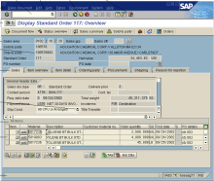
Recap: Information System Pyramid
Motivation and Terminology
Operational Systems
Strategic Systems
Analytical Systems
DSS
Vertical Integration (e.g., ETL)
Lecture 02
DWH
Material
ERP
CRM
SCM
eCommerce
Horizontal Integration (e.g., EAI)
Lecture 03 (today)

Slide 10
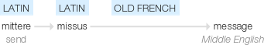
Messaging
Motivation and Terminology
Def: Message
Piece of information in certain structure
Send from source (transmitter) over channel to destination (receiver)
Syntax: different message formats (binary, text, XML, JSON, Protobuf)
Semantic: different domain-specific message schemas (aka data models)
Synchronous Messaging
Strict consistency requirements
Overhead for distributed transactions via 2PC
Low local autonomy, usually data-driven
Asynchronous Messaging
Loose coupling, eventual consistency requirements
Batching for efficient replication and updates
Latency of update propagation
[Credit: https://www.gstatic.com/ onebox/dictionary/etymology]
S2
S1
S3
S1
S2

Slide 11
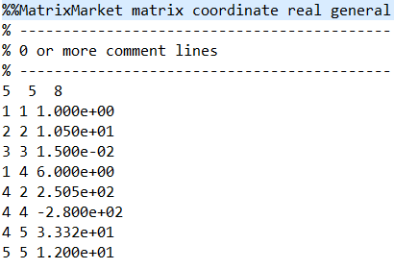
Types of Data Formats
Motivation and Terminology
General-Purpose Formats
CLI/API access to DBs, KV-stores, doc-stores, time series DBs, etc
CSV (comma separated values)
JSON (javascript object notation), XML, Protobuf
Sparse Matrix Formats
Matrix market: text IJV (row, col, value)
Libsvm: text compressed sparse rows
Scientific formats: NetCDF, HDF5
Large-Scale Data Format
ORC, Parquet (column-oriented file formats)
Arrow (cross-platform columnar in-memory data)
Domain-specific Formats: often binary, structured text, XML
Notes:
ORC .. Optimized row colum
NetCDF (network Common Data Form) is a set of interfaces for array-oriented data access and a freely distributed collection of data access libraries for C, Fortran, C++, Java, and other languages.
The Hierarchical Data Format version 5 (HDF5), is an open source file format that supports large, complex, heterogeneous data. HDF5 uses a "file directory" like structure that allows you to organize data within the file in many different structured ways.

Slide 12
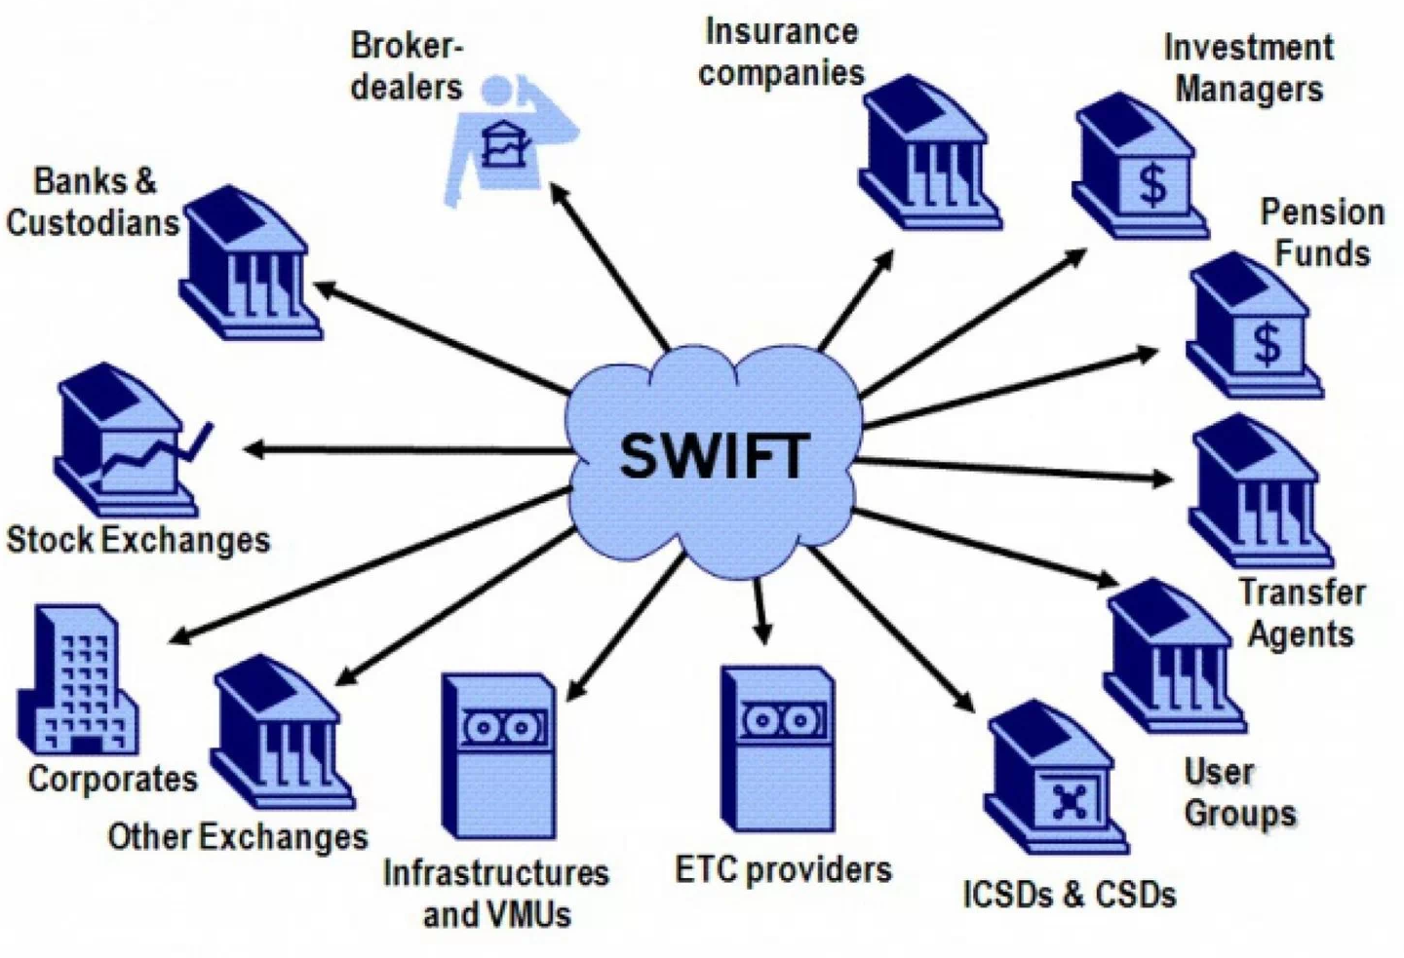
Example Domain-specific Message Formats
Motivation and Terminology
Finance: SWIFT
Society for Worldwide Interbank Financial Telecommunication
>10,000 orgs (banks, stock exchanges, brokers and traders)
Network and message formats for financial messaging
MT and MX (XML, ISO 20022) messages
Health Care: HL/7, DICOM
Health Level 7 (HL7) messages for clinical and admin data exchange → v2.x structured text msgs, v3 XML-based msgs
Digital Imaging and Communications in Medicine (DICOM)
Automotive: ATF, MDF
Association for Standardisation of Automation and Measuring Systems (ASAM)
E.g., Open Transport Data Format (ATF), Measurement Data Format (MDF), calibrations (CDF), auto-lead XML (ADF), open platform communications (OPC)
Note: Sometimes Large-scale analytics over histories of messages (e.g., health care analytics, fraud detection, money laundering)
[https://ihodl.com]

Slide 13
Types of Message-Oriented Middleware
Motivation and Terminology
#1 Distributed TXs & Replication
#2 Message Queueing
Persistent message queues with well-defined delivery semantics
Loose coupling of connected systems or services (e.g., availability)
#3 Publish Subscribe
Large number of subscribers to messages of certain topics/predicates
Published messages forwarded to qualifying subscriptions
#4 Integration Platforms
Inbound/outbound adapters for external systems
Sync and async messaging, message transformations, enrichment

Slide 14
Distributed TX & Replication Techniques

Slide 15
Distributed Database Systems
Distributed TX & Replication Techniques
Global Q
Distributed DBS
Distributed database: Virtual (logical) database that appears like a local database but consists of multiple physical databases
Multiple local DBMS, components for global query processing
Terminology: virtual DBS (homogeneous), federated DBS (heterogeneous)
Challenges
Tradeoffs: Transparency – autonomy, consistency – efficiency/fault tolerance
#1 Global view and query language → schema architecture
#2 Distribution transparency → global catalog
#3 Distribution of data → data partitioning
#4 Global queries → distributed join operators, etc
#5 Concurrent transactions → 2PC
#6 Consistency of copies → replication
DB₁
Q’
Q’’’
Q’’
DB₂
DB₄
DB₃
Beware: Meaning of “Transparency” (invisibility) here

Slide 16
Two-Phase Commit (2PC)
Distributed TX & Replication Techniques
Recap: Database Transaction
A transaction (TX) is a series of steps that brings a database from a consistent state into another (not necessarily different) consistent state
ACID properties (atomicity, consistency, isolation, durability)
Problems in Distributed DBS
Node failures, and communication failures (e.g., network partitioning)
➔ Distributed TX processing to ensure consistent view (atomicity/durability)
Two-Phase Commit (via 4*(n-1) msgs)
Phase 1 PREPARE: check for successful completion, logging
Phase 2 COMMIT: commit/abort, release locks, and other cleanups
What happens if nodes unavailable, or report errors on prepare
Global TX
Coordinator
ready
DB₁
ready
prepare
TX
TX
prepare
commit
TX
commit
DB₂
DB₄
DB₃
ready
Cohorts
prepare
commit

Slide 17

Two-Phase Commit (2PC), cont.
Distributed TX & Replication Techniques
Excursus: Wedding Analogy
Coordinator: marriage registrar
Phase 1: Ask for willingness
Phase 2: If all willing, declare marriage
#1 Problem: Many Messages
4(n-1) messages in successful case, otherwise additional msgs
#2 Problem: Blocking Protocol
Local node PREPARE → FAILED ➔ TX is guaranteed to be aborted
Local node PREPARE → READY ➔ waiting for global response
Failure of coordinator+cohort, or participating coordinator → outcome unknown
Other Problems
Atomicity in heterogeneous systems w/o XA
Deadlock detection, optimistic concurrency control, etc
Note: APIs for automatic vs programmatic 2PC

Slide 18
Extended Distributed Commit Protocols
Distributed TX & Replication Techniques
2PC Improvements
Hierarchical Commit: establish message tree from coordinator to local nodes ➔ parallelization of message handling over inner nodes
Presumed Abort: assume abort if there are no commit log entries ➔ asynchronous logging of aborts, no ACK on abort
1PC (fewer messages)
Combine TX operations w/ PREPARE to reduce 2(n-1) messages
Local nodes enter waiting state earlier
3PC (non-blocking)
a) CAN COMMIT? Yes/no
b) PREPARE COMMIT? Ack
c) COMMIT? Ack
Cohorts can collectively decide on commit if at least one in PREPARE-COMMIT
Protocol | # Msgs
1PC | 2(n-1)
2PC | 4(n-1)
3PC | 6(n-1)

Slide 19
Replication Overview
Distributed TX & Replication Techniques
T1
Replication Transparency
Replication
Redundancy of stored fragments
Availability/efficiency (read) vs update overhead / storage
Replication Techniques
VDBMS
Node 1
Replication
Node 2
Copy-Update Strategies
All
Selected
ROWA
ROWAA
Predetermined
Consensus
Primary Copy
Majority Consensus
Dynamic Voting
Hierarchical Quorum

Slide 20


Replication Techniques
Distributed TX & Replication Techniques
logical
ROWA
Read-One/Write-All
Read: good performance/availability
Write: high overhead and only successful if all available
ROWAA
Read-One/Write-All-Available
Relaxed availability requirement for write operations
physical
logical
physical
„Update anywhere-anytime-anyway transactional replication has unstable behavior as the workload scales up: a ten-fold increase in nodes and traffic gives a thousand fold increase in deadlocks or reconciliations. Master copy replication (primary copy) schemes reduce this problem.”
[Jim Gray, Pat Helland, Patrick E. O'Neil, Dennis Shasha: The Dangers of Replication and a Solution, SIGMOD 1996]

Slide 21
Replication Techniques, cont.
Distributed TX & Replication Techniques
Primary Copy
Update single primary copy synchronously
Asynchronous propagation of updates to other replicates, read from all
Pro: Higher update performance, good locality, and availability
Con: Potentially stale read on secondary copies (w/ and w/o locks)
Load balancing: place PC of different objects on different nodes
Primary Copy
SC₁
Secondary Copies
T1: write r₁(x)
PC
SC₂
sync
async
SC₃

Slide 22


Replication Techniques, cont.
Distributed TX & Replication Techniques
Consensus Protocols
Basic idea: voting if read/write access is permissible (with regard to serializability)
Each replicate has vote → all votes Q
Read quorum Q_{R} and write quorum Q_{W}
#1 Majority Consensus
Read requires Q_{R} > Q/2, lock all and read newest replica
Write requires Q_{W} > Q/2, lock and update all
#2 Dynamic Quorums
Problem: network partitioning → retain vote for updated replica
#3 Hierarchical Quorums
Obtain majority of nodes in multiple levels of the tree
Overlap Rules:
Q_{R} + Q_{W} > Q
Q_{W} > Q/2
g₁
g₂
g₃
1
2
3
4
5
6
7
8
9

Slide 23
Asynchronous Messaging

Slide 24

Message Queueing
Asynchronous Messaging
Message
Atomic packet of data + meta data, wrapped as a message
Message Queue
FIFO or priority queue of messages
In-memory, sometimes with persistent storage backend and transactional semantics
Internal IDs, receive time
Remote Message Queues
Loose coupling of applications (no direct API calls, etc)
Independent of HW and OS
4
Storage
3
2
App 1
App 2
Message channel

Slide 25
Recap: Message Delivery Guarantees
Asynchronous Messaging
#1 At Most Once
“Send and forget”, ensure data is never counted twice
Might cause data loss on failures
#2 At Least Once
“Store and forward” or acknowledgements from receiver, replay stream from a checkpoint on failures
Might create incorrect state (processed multiple times)
#3 Exactly Once
“Store and forward” w/ guarantees regarding state updates and sent msgs
Often via dedicated transaction mechanisms

Slide 26


Example Systems
Asynchronous Messaging
IBM MQSeries
Message-oriented middleware for async queue communication
Connections/objects: MQCONN, MQDISC, MQOPEN, MQCLOSE
Queue ops: MQCRTMH, MQPUT, MQGET, MQSET, MQINQ, MQSTAT
Transactions: MQBEGIN, MQBACK, MQCMIT
JMS (Java Message Service)
J2EE API of messaging services in Java (messages, queues, sessions, etc)
JMS providers: e.g., IBM Websphere MQ, Apache ActiveMQ, RabbitMQ
AWS Simple Queueing Service (SQS)
Message queueing service for loose coupling of micro services
Default queue: best effort order, at-least-once, high throughput
FIFO: guarantees FIFO order, and exactly-once

Slide 27
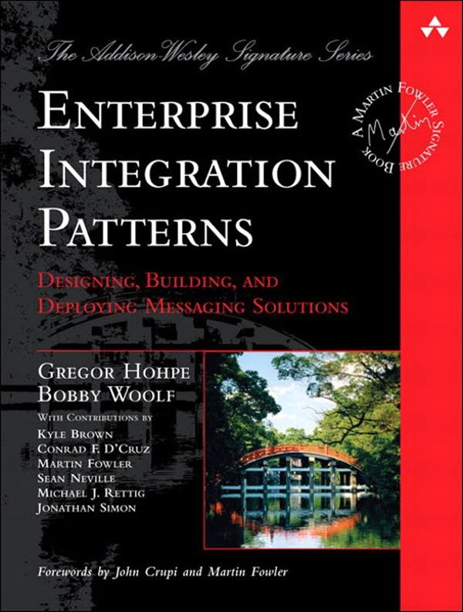

Parallel Message Processing
Asynchronous Messaging
[Gregor Hohpe, Bobby Woolf: Enterprise Integration Patterns, Addison-Wesley, 2004]
#1 Pipeline Parallelism
“Pipes and filters”: leverage pipeline parallelism of chains of operators
More complex w/ routing / control flow (possible via punctuations)
#2 Operator Parallelism
Multi-threaded execution of multiple messages within one operator (pattern “competing consumers”)
Requires robustness against partial out-of-order, or resequencing
#3 Key Range Partitioning
Explicit routing to independent pipelines (patterns “message router”, “content-based router”)
Ordering requirements only within each pipeline
o₁
o₂
o₃
o₁
o₂
o₃
o₁
o₂
o₃
o₁
o₂
o₃
o₁
o₂
o₃
o₁
o₂
o₃

Slide 28
Publish/Subscribe Architecture
Asynchronous Messaging
Overview Pub/Sub
Key Characteristics
Often imbalance between few publishers and many subscribers
Topics: explicit or implicit (e.g., predicates) groups of messages to publish into or subscribe from
Addition and deletion of subscribers rare compared to message load
ECA (event condition action) evaluation model
Often at-least-once guarantee
M
Subscriber 1
N
Publisher 1
Subscriber 2
Topics
Topics
Topics
Publisher 2
Subscriber 3
Subscriber 4

Slide 29
Publish/Subscribe Architecture, cont.
Asynchronous Messaging
Subscriber Filtering
Complex predicates of range filters, equi-predicates, and negation
Goal: Avoid naïve scan over all subscriber predicates / topics
Matching Algorithm
Matching event against a set of subscriptions
Approach: sorting and parallel search tree
[Guruduth Banavar et al: An Efficient Multicast Protocol for Content-Based Publish- Subscribe Systems. ICDCS 1999]
*
1
Example Publish {a₁=1, a₂=2, a₃=3, a₅=2}
a1
*
2
*
2
a2
1
*
3
*
3
1
2
*
3
a3
*
1
1
1
2
1
2
*
1
1
2
1
*
a4
4
*
3
2
1
*
2
3
*
1
2
3
a5
Notes:
Note: WL Subskriptionssysteme – minor example errors
Note 2: see XGBoost handling of default paths for missing values
TODO double check example

Slide 30

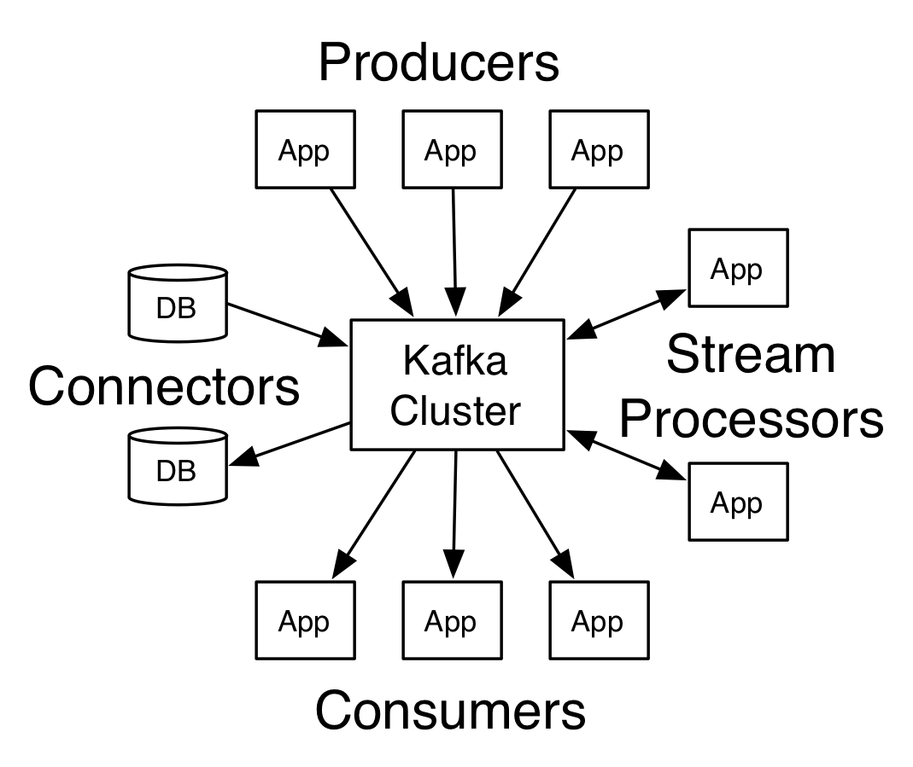
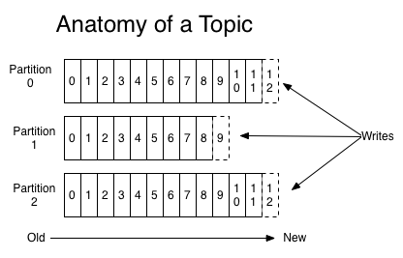
Apache Kafka
Asynchronous Messaging
[https://kafka.apache.org/ documentation]
Overview System Architecture
Publish & Subscribe system w/ partitioned topics
Storage of data streams in distributed, fault-tolerant cluster (replicated)
Configurable retention periods (e.g., days)
APIs: producer API, consumer API, streams API, Connector API
Topics
Explicit categories w/ user-defined (semantic) partitioning
Partitions are ordered, immutable sequences of records (log) w/ offsets
Current offset per consumer stored
Notes:
Example Deutsche Bahn: 1.6M status messages/day through kafka

Slide 31
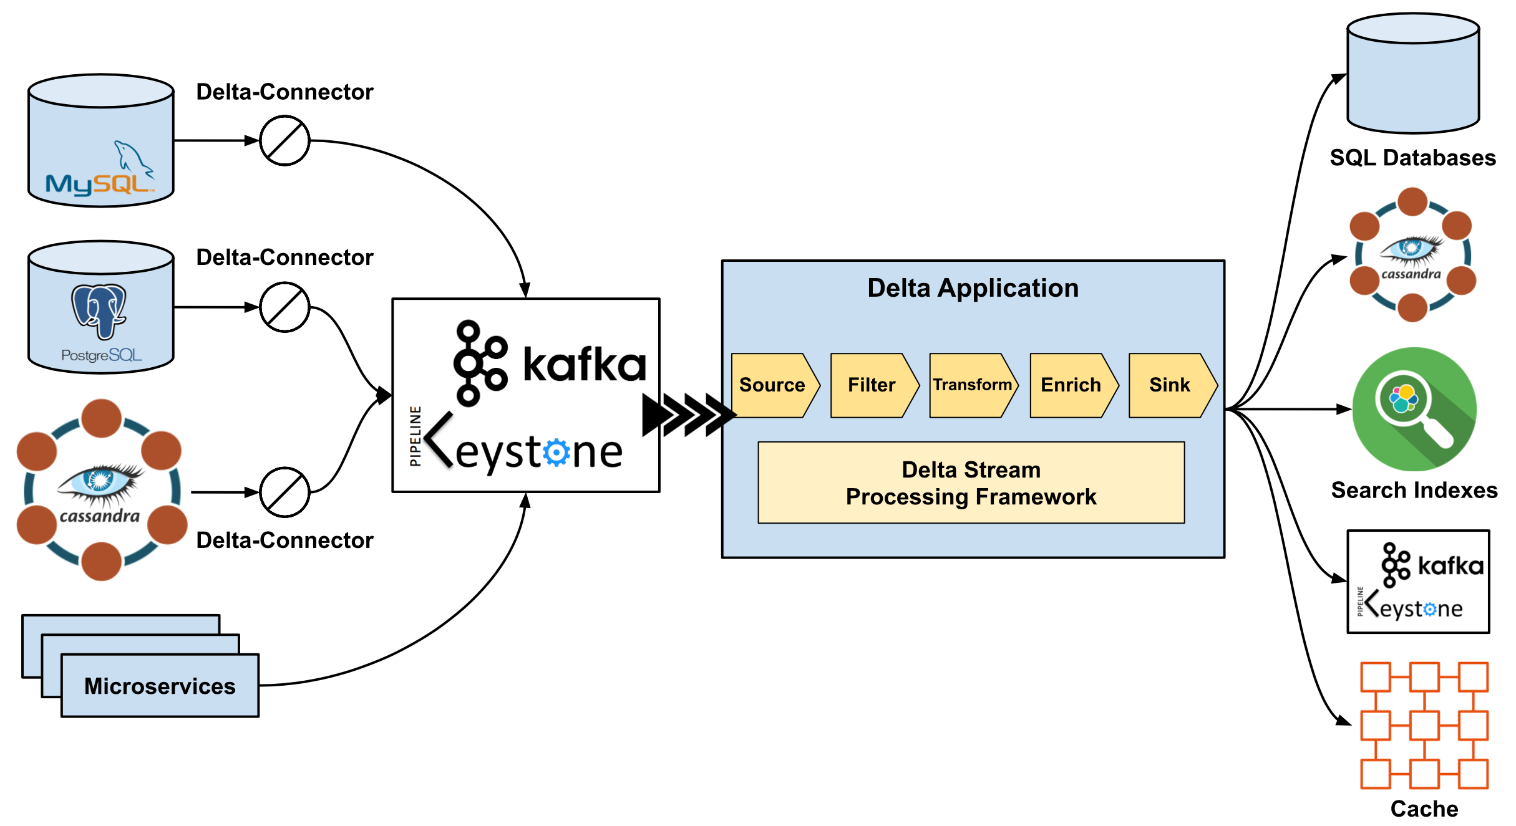
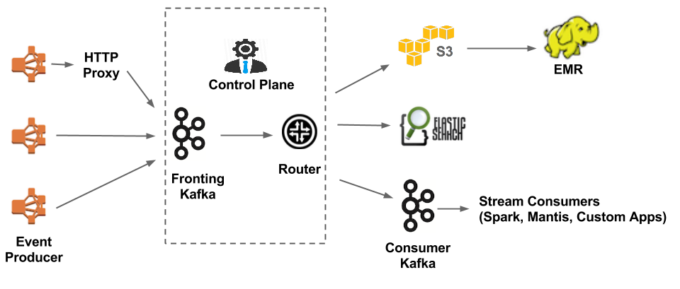
Apache Kafka, cont.
Asynchronous Messaging
[https://medium.com/netflix-techblog/delta-a-data-synchronization-and-enrichment-platform-e82c36a79aee, Oct 15 2019]
Netflix Delta
A Data Synchronization and Enrichment Platform
DSL and UDF APIs for custom filters and transformations
Netflix Keystone (Kafka frontend)
~500G events/day (5M events/s peak)
~1.3PB/day
[https://medium.com/netflix-techblog/evolution-of-the-netflix-data-pipeline-da246ca36905]
Notes:
Netflix Keystone since 2015, 100s of event types, 8.6M events/s and 21GB/s peak

Slide 32
Message-oriented Integration Platforms

Slide 33
Overview
Message-oriented Integration Platforms
Motivation
Integration of many applications and systems via common (information resources) IR
Beware: syntactic vs semantic data models
Evolving Names
Enterprise Application Integration (EAI)
Enterprise Service Bus (ESB)
Message Broker
Example Systems
IBM App Connect Enterprise (aka Integration Bus, aka Message Broker)
MS Azure Integration Services + Service Bus (aka Biztalk Server)
SAP Process Integration (aka Exchange Infrastructure)
SQL AG TransConnect
Middleware

Slide 34
Common System Architecture
Message-oriented Integration Platforms
Modeling (Flow Design)
Deploy
External System
SWIFT Inbound Adapter
sync
Orchestration Engine
RDBMS Outbound Adapter
External System
Message Flows
External System
HL/7 Adapter
File Adapter
External System
async
…
HL/7 Adapter
External System
External System
SAP Adapter
Scheduler
SAP Adapter
External System
Temporary Data Store

Slide 35
Common System Architecture, cont.
Message-oriented Integration Platforms
#1 Synchronous Message Processing
Event: client input message
Client system blocks until message flow executed to output messages delivered to target systems
#2 Asynchronous Message Processing
Event: client input message from queue
Client system blocks until input message stored in queue
Asynchronous message flow processing and output message delivery
Optional acknowledgement, when input message successfully processed
#3 Scheduled Processing
Event: time-based scheduled message flows (cron jobs)
Periodic data replication and loading (e.g., ETL use cases)
Notes:
Scheduler for automated repetitive jobs

Slide 36
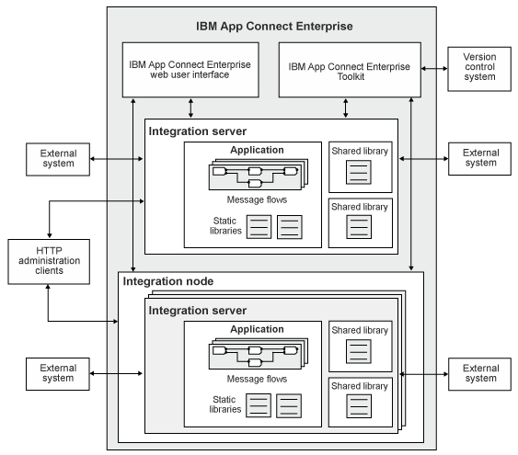
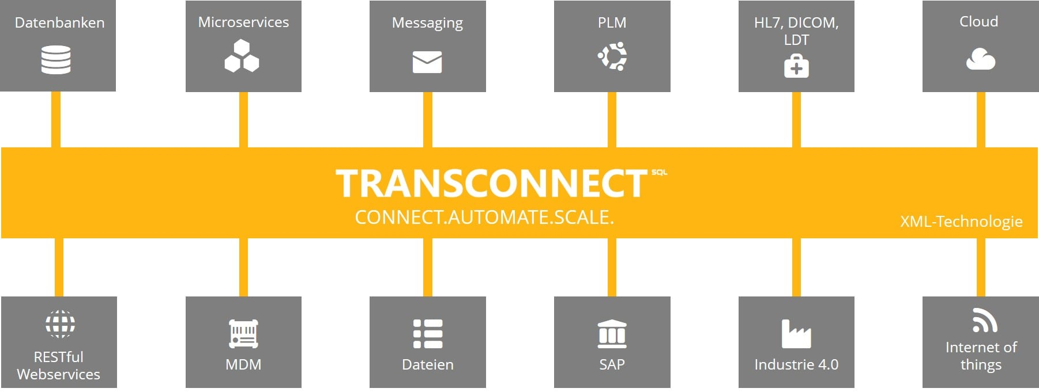
Commercial Systems
Message-oriented Integration Platforms
[https://azure.microsoft.com/mediahandler/files/ resourcefiles/azure-integration-services/ Azure-Integration-Services-Whitepaper-v1-0.pdf]
[IBM App Connect Enterprise: https://www.ibm.com/support/ knowledgecenter/en/SSTTDS_11.0.0/ com.ibm.etools.mft.doc/ab20551_.htm]
[SQL AG: https://www.transconnect-online.de/]

Slide 37
Message Delivery Guarantees, cont.
Message-oriented Integration Platforms
Example Exactly-Once
Remote ID Maintenance w/ TX capability
Local ID Maintenance w/ TX capability
w/o TX capability: at-least-once
[Credit: SQL AG - https://www.transconnect-online.de/]

Slide 38
Recap: XML (Extensible Markup Language)
Message-oriented Integration Platforms
XML Data Model
Meta language to define specific exchange formats
Document format for semi-structured data
Well formedness
XML schema / DTD
XPath (XML Path Language)
Query language for accessing collections of nodes of an XML document
Axis specifies for ancestors, descendants, siblings, etc
XSLT (XML Stylesheet Language Transformations)
Schema mapping (transformation) language for XML documents
XQuery
Query language to extract, transform, and analyze XML documents
<?xml version=“1.0“ encoding=“UTF-8“?>
<data>
<student id=“1”>
<course id=“INF.01014UF” name=“Databases”/>
<course id=“706.550” name=“AMLS”/>
</student>
<student id=“5”>
<course id=“706.004” name=“Databases 1”/>
</student>
</data>
/data/student[@id=‘1’]/course/@name
“Databases”
“AMLS”

Slide 39
XSLT in Integration Platforms
Message-oriented Integration Platforms
Problem
XML often used as external and internal data representation
Different schemas (message types) ➔ requires mapping
XSLT Overview
XSLT processor transforms input XML document according to XML stylesheet to output XML documents
Subtree specifications via XPath, loops, branches built-in functions for text processing, etc
Streaming: STX or XSLT 3.0 streaming
CSV and JSON input/output possible
Note: Similar tools/libraries for JSON
tf.xsl
in xml
XSLT Processor
out xml

Slide 40
XSLT Example
Message-oriented Integration Platforms
<?xml version="1.0" encoding="UTF-8"?>
<xsl:stylesheet version="2.0“ xmlns:xsl="http://www.w3.org/1999/XSL/Transform">
<xsl:template match="/">
<xsl:element name=“suppliers">
<xsl:for-each select="/resultsets/resultset[@Tablename='Supplier']/row">
<xsl:element name=“supplier">
<xsl:attribute name=“ID"><xsl:value-of select="Suppkey"/></xsl:attribute>
<xsl:element name="Name"><xsl:value-of select="SuppName"/></xsl:element>
<xsl:element name="Address"><xsl:value-of select="SuppAddress"/></xsl:element>
</xsl:element>
</xsl:for-each>
</xsl:element>
</xsl:template>
</xsl:stylesheet>
<resultssets>
<resultset Tablename=“Supplier”>
<row>
<Suppkey>7</Suppkey>
<SuppName>MB</Suppname>
<SuppAddress>1035 Coleman Rd</SuppAddress>
</row>
<row> … </row>
</resultset>
</resultsets>
<suppliers>
<supplier ID=“7”>
<Name>MB</Name>
<Address>1035 Coleman Rd</Address>
</supplier>
<supplier> … </supplier>
<suppliers>

Slide 41
Summary and Q&A
Distributed TX & Replication Techniques
Distributed commit protocols
Different replication techniques
Asynchronous Messaging
Message queueing systems
Publish/subscribe systems
Message-oriented Integration Platforms
System architecture and systems
Schema mappings via transformations
Next Lectures (Data Integration Techniques)
04 Schema Matching and Mapping [Nov 08]
05 Entity Linking and Deduplication [Nov 15]

